Slide 1
Promotion provider
TANAWAT SITTHITAN
NATTAKIT CHAIWONGSRI
ADVISOR
PHUDINAN SINGKHAMFU

Slide 2
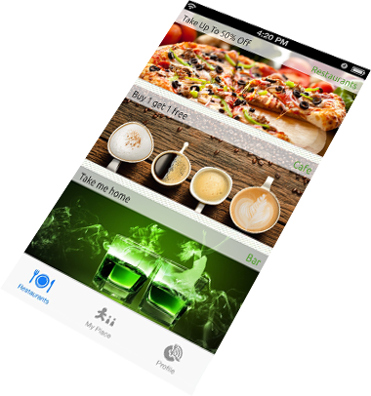
What is promotion provider? And why?
iPhone application
Update real time promotion
Notification when get in 20 meters.
Collecting points

Slide 3



How about others?

Slide 4
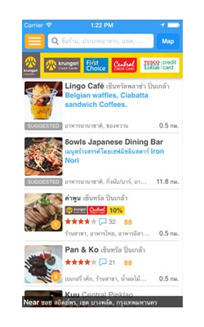
Wongnai
Finding restaurant
Sharing review of restaurants
More than 180,000 restaurants
Log in with Facebook use a lot of time
Log out, sometime do nothing

Slide 5
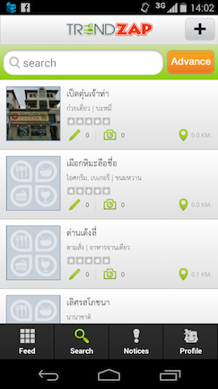
Trend zap
Finding restaurants
Navigate user to restaurant
User rating
Allow only one review per restaurant
Add the picture only one a time

Slide 6
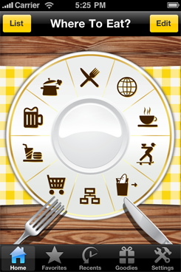
Where to eat
Over 45 cuisines and 30 food types
Shake-to-Suggest restaurant
Not up to date,
Many places already shut down.

Slide 7

aims
Conveniently find a special offer or promotion
Notification while user get close to the promotion
Develop this application to be guidance for the tourist

Slide 8

Objectives
Provide a promotion and discount to user.
Provide the recommended a restaurant to tourists.
Provide a system’s notification to notify user.

Slide 9

Quality standard
ISO 29110
Suite for 2 up to 25 people
Project management process
Software implementation process

Slide 10


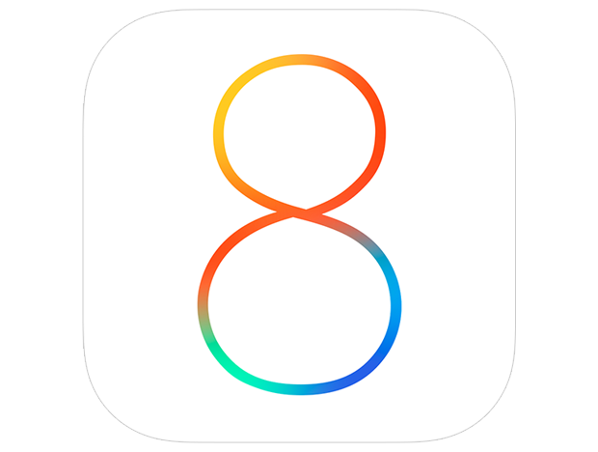


technologies we are going to use
Notes:
Json or Java Script Object Notation is the way to make javascript able to exchange data between server and client.
Bootstrap is HTML, CSS, and JavaScript framework for developing responsive web site.
iOS, The world’s most advanced mobile operating system created and develop by apple

Slide 11





technologies we are going to use
Notes:
Hypertext Preprocessor is a widely-used open source and it’s suited for web development
MYSQL is an open source Relational Database Management System that uses SQL to manage content in database
Medoo The Lightest PHP database framework to accelerate development.
Google map is a Web-based service that provides detailed information about geographical regions and sites around the world
Xampp is apache web server used for simulate web server to test script on web site on our local machine

Slide 12




Tools we are going to use
Xcode
iOS simulator
Notes:
Xcode is IDE for develop OS X and iOS application
MySQL Workbench is an unified visual tool for database architects, developers, and DBAs. MySQL Workbench provides data modeling and SQL development
PhpStorm provides an editor for PHP, HTML and JavaScript with on-the-fly code analysis, error prevention and automated refactorings for PHP and JavaScript code.

Slide 13
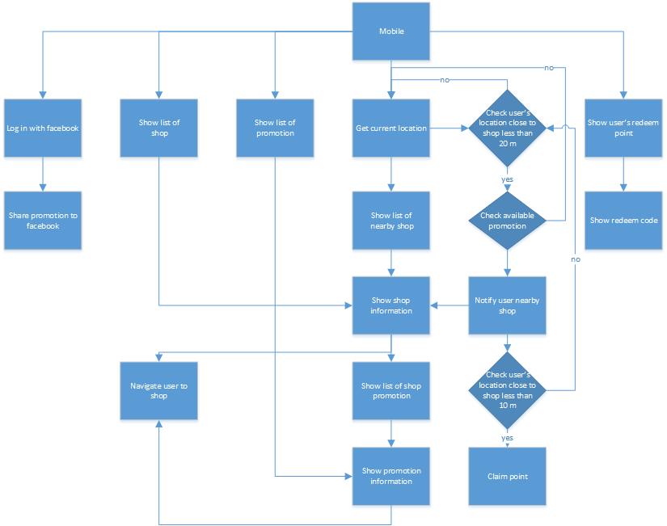
Chart diagram mobile application

Slide 14
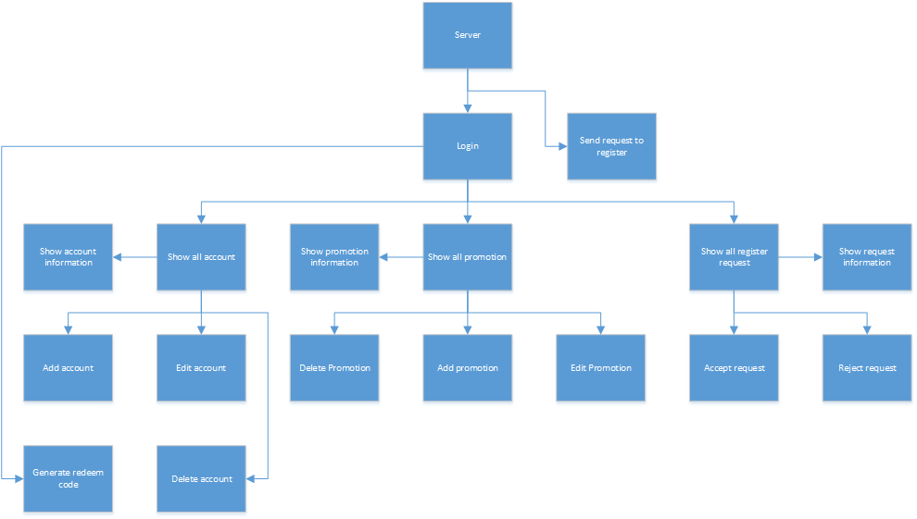
Chart diagram web server

Slide 15
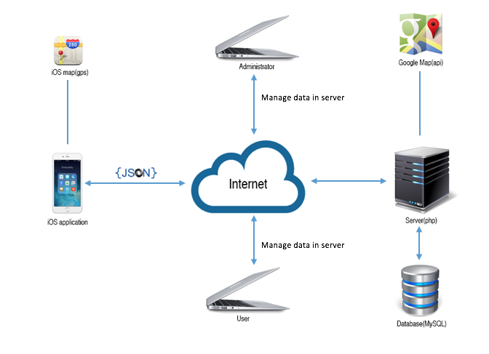
System architecture

Slide 16
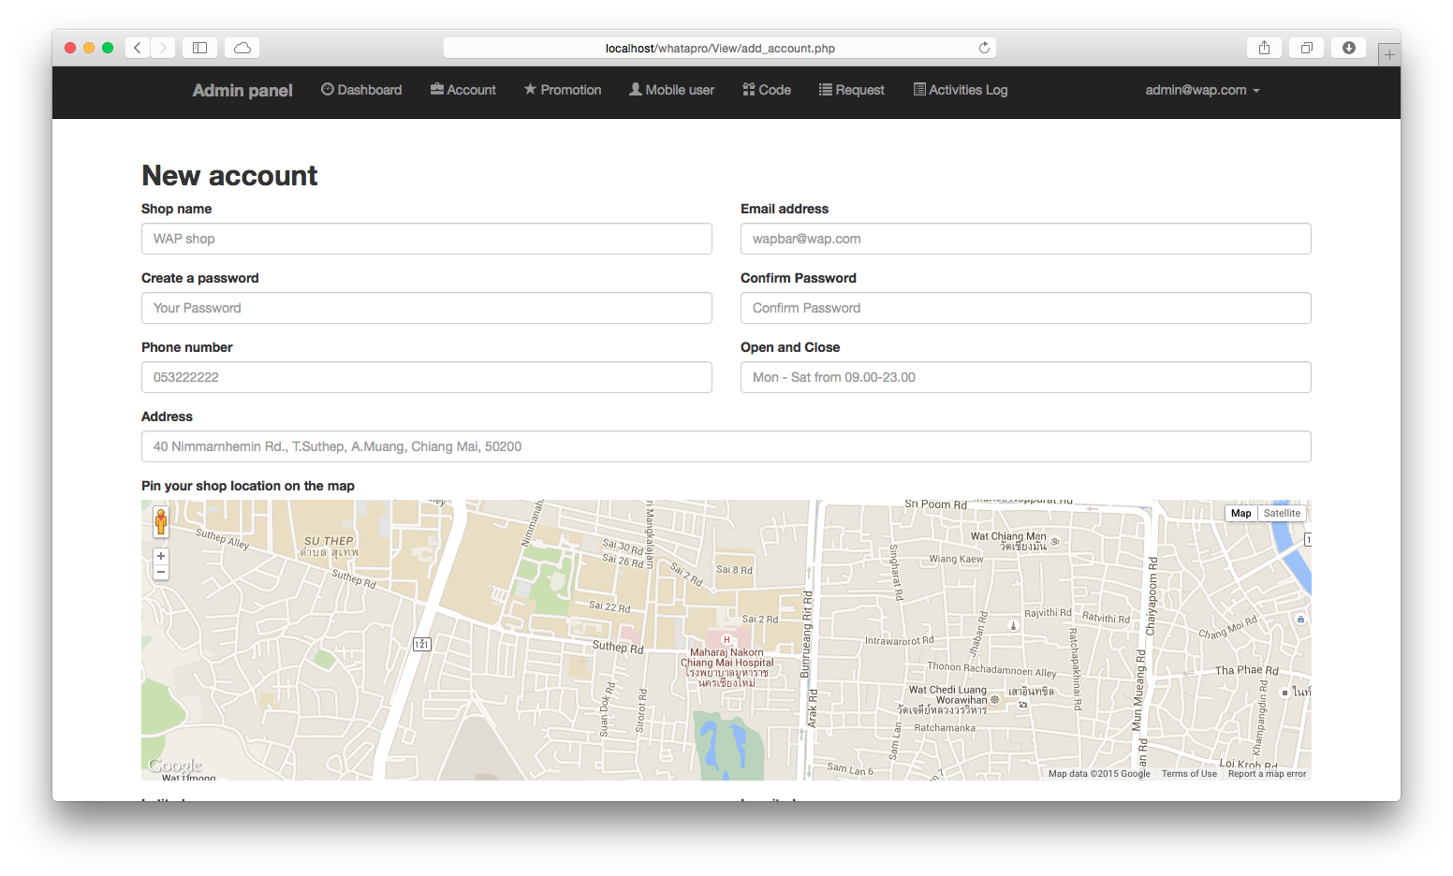
Deliverables web server
Add or insert
Search and find
Generate
Notes:
Add - Accounts and promotions that easily to add with minimal effort.
Search - The best way to find the shop or promotion which is in your mind
Generate - Very easy to provide unique redeem code and also with barcode to mobile application.

Slide 17
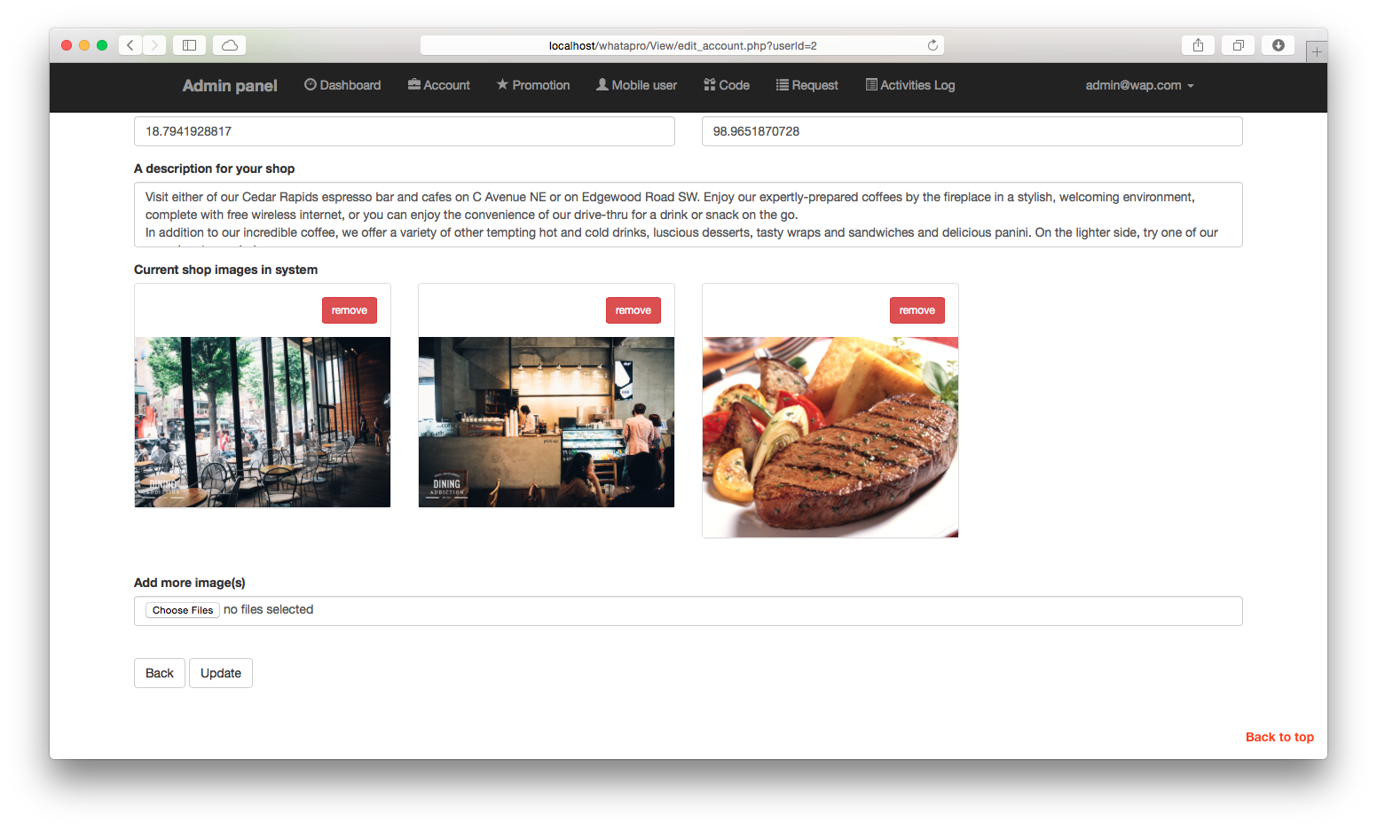
Deliverables web server
Edit or update
The usability with real time updating screen
Secure and permission
Notes:
Edit - Edit and update the information by changing the existing information or remove it and insert new information.
Usability - Prevent losing data via updating the shop information or promotion information.
Secure - Without having email and password, system will not allowed to login. “Permission denied” will show if user role try to access administrator page. It also show if user does not login and try to redirect page by URL.

Slide 18
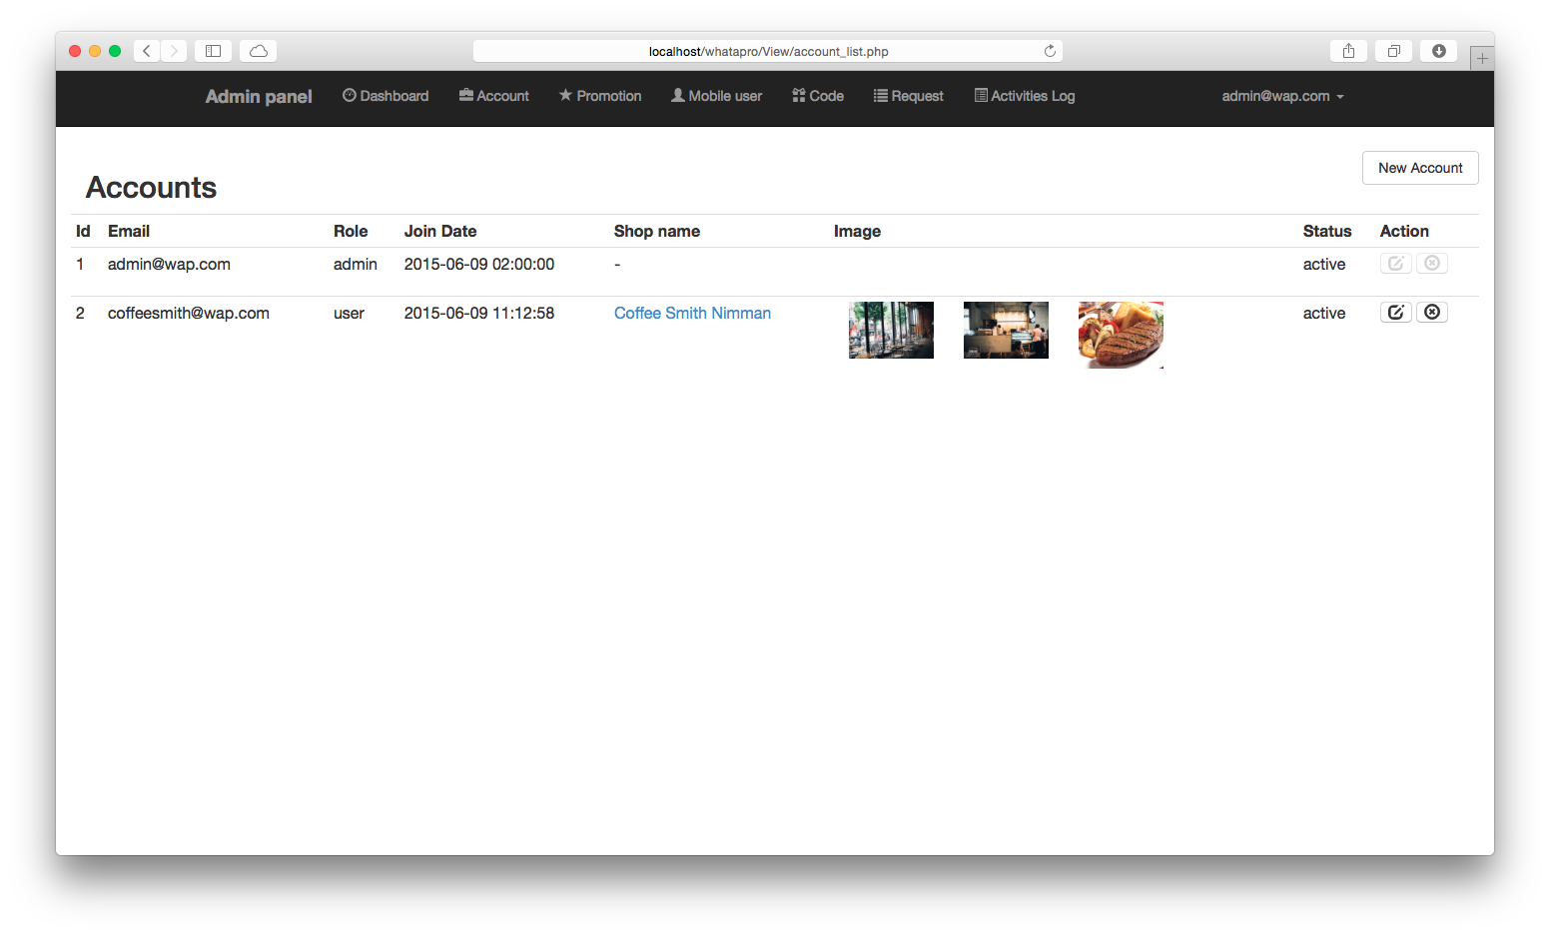
Deliverables web server
Show or display
Delete
Notes:
Show - Easy to view account, promotion, logs and register request
List of logs
Show single account information
Delete -Lets user delete unwanted promotions and accounts.

Slide 19
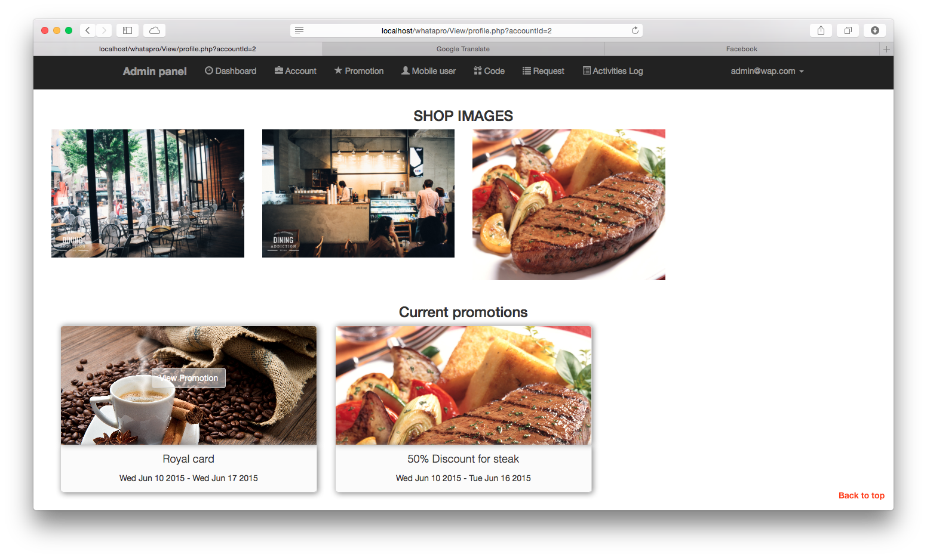
Deliverables web server
Track
Notes:
Track
Tracks every actions of all user in system by record logs, letting admin to track promotion. The software is designed to let admin view which promotion are belonging to each shop.

Slide 20
Deliverables mobile application
Notification
Navigate
Show and display
Claim point by walk into shop area
Connecting to Facebook
Notes:
Claim point – By user is in range then click claim point

Slide 21

Deliverables documents
Proposal
Project plan
Software requirement specification
Software design documentation
Unit test record
Traceability record
Test plan and Test record
Integration test record
System test record

Slide 22

limits
This application not available without Internet connection
GPS may not accurate on rainy day

Slide 23
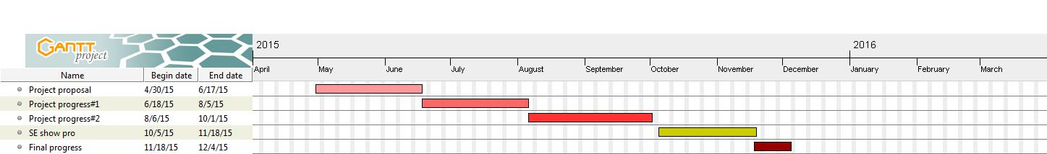
Schedule Overview

Slide 24
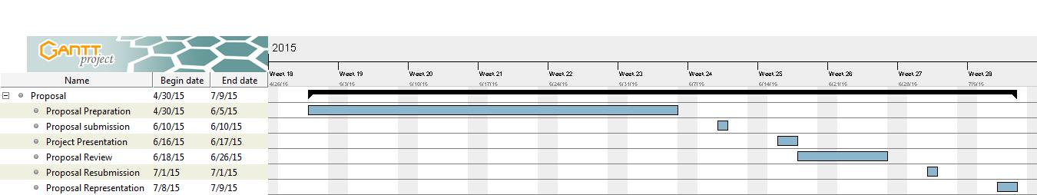
Schedule Proposal

Slide 25
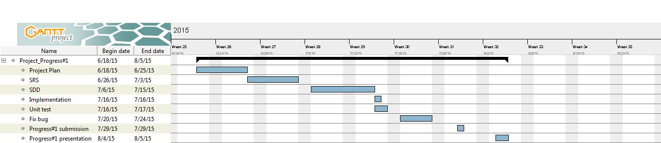
Schedule Progress 1
Feature# 1 Managing shop owner: System provide managing function(add, update, delete)
Feature# 2 Managing promotion: System provide managing function(add and delete)
Feature# 3 Changing password: All user type can change their password

Slide 26
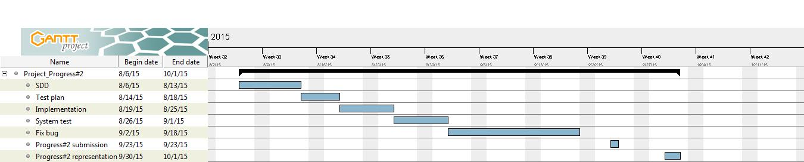
Schedule Progress 2
Feature# 4 Show promotion information: System provide the promotion information
Feature# 5 Notification: System will notify user application when they get closer than 20 meters
Feature# 6 Turn off notification: User application can turn off notification

Slide 27
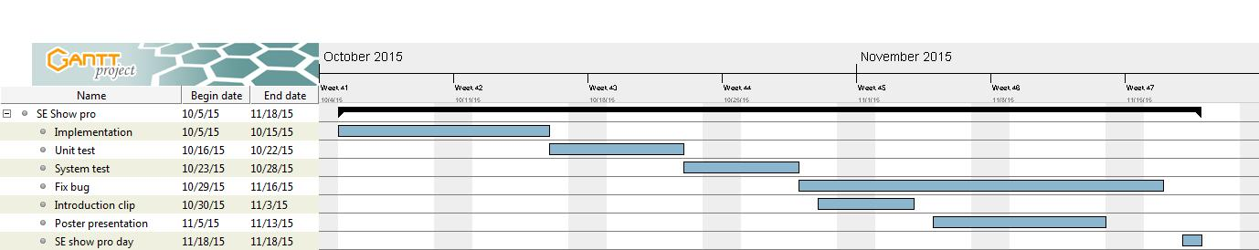
Schedule SE show pro
Feature# 7 Searching: User application can search by place’s name
Feature# 8 Near by: User application can see the promotion place in setting range
Feature# 9 Single sign on: User application can sign in to system by using Facebook’s account
Feature# 10 Sharing promotion: User application can share any promotions to Facebook

Slide 28
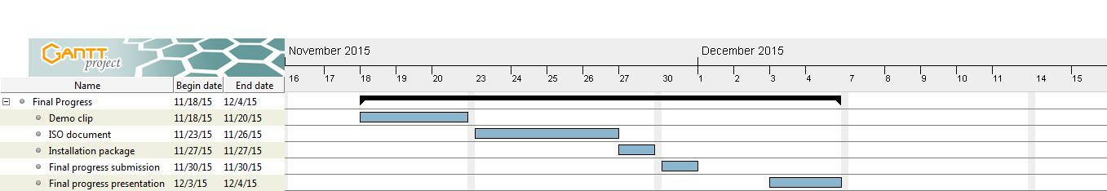
Schedule Final Progress

Slide 29
Q&A

